Slide 1
ALICE 3 Prospects for iThemba LABS/SA-ALICE

Slide 2
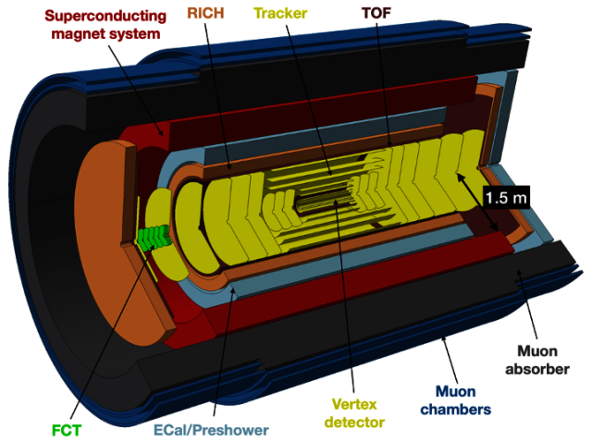
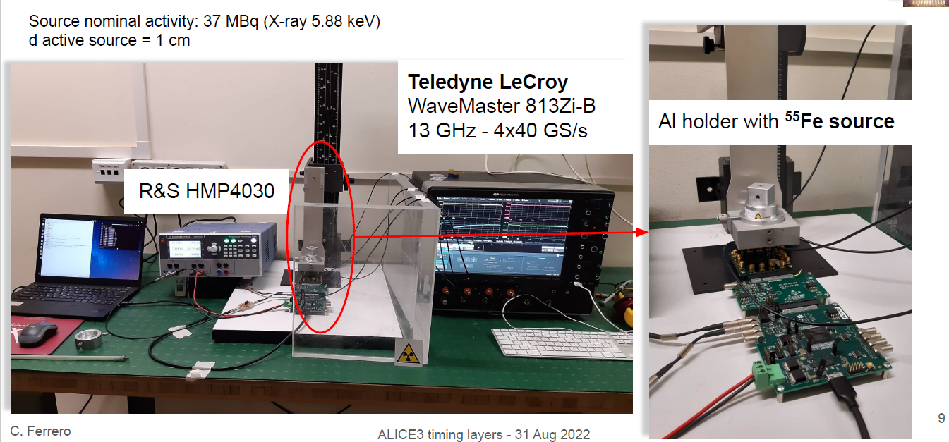
Possible ALICE 3 projects
TOF - LGAD
Possible Contributions:
Parallel test bench setup to investigate time resolution
Cost for test bench : ̴̴̴ 1M rands
Improvement and production of the existing LGAD PCB (???)
Readout test bench (Aria 10 FPGA + LGAD prototype)
TOF – Monolithical CMOS
Possible Contributions:
Parallel testbench to validate the CMOS technology
Understanding the chip functionality and providing simulation tests for improvements
Readout test bench (Aria 10 FPGA + CMOS prototype)

Slide 3
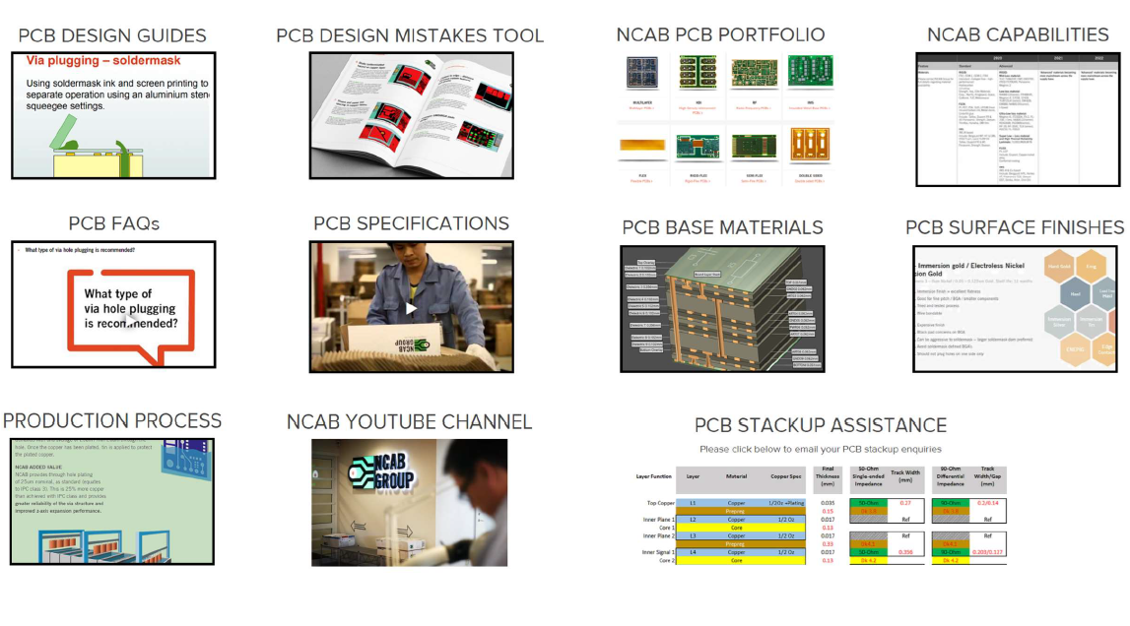
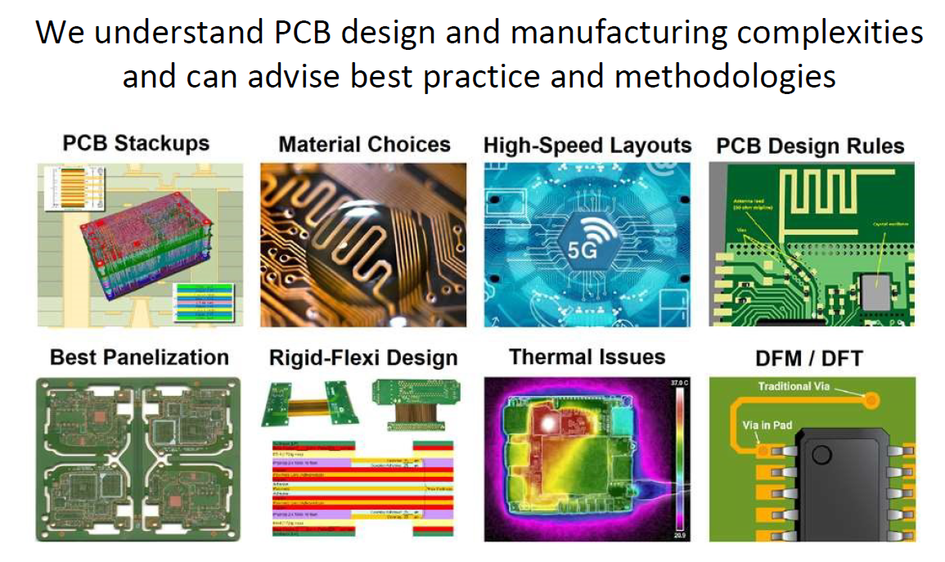
Possible ALICE 3 project Resources
What tools we need for the test bench?
List of test bench equipment list mentioned in next slide
What are our resources for this?
RDTS understaffed → I can contribute to the training and overseeing of the work project to a certain percentage (if approved)
We therefore need students (SUN,CPUT,UCT) to contribute 100% → potential MEng project
Interns
Local Recourses if we go the PCB production route as well → PCB manufactures established
Jemstech (Information still to be gathered but used by ATLAS based in Centurian)
EDA Technologies (based in Centurian):
EDA technologies capabilities and resources

Slide 4
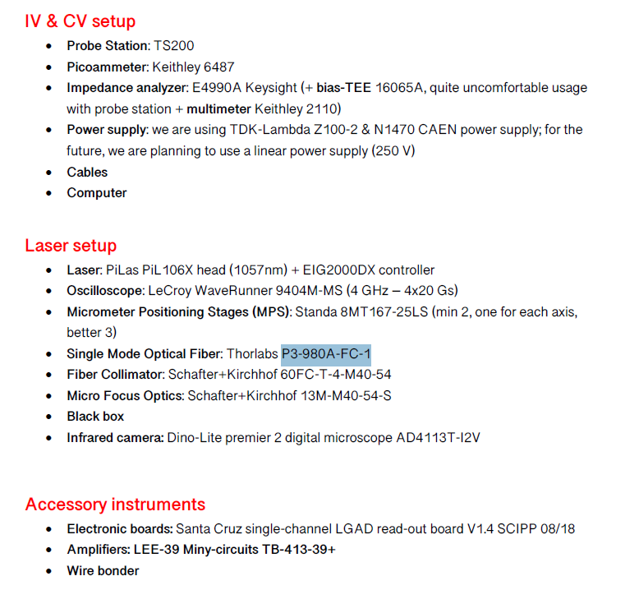
Possible ALICE 3 project test bench
Cost: ̴̴̴̴1M rands

Slide 5
Possible ALICE 3 project test bench estimates
Probe Station: TS200 (No price found → quote requested)
Keithley 6487
E4990A Keysight $33000
multimeter Keithley 2110 $1000
TDK-Lambda Z100-2 $1500
N1470 CAEN power supply
Computer $5 000 – $10 000 (depending on what kind of machine specs is needed)
Cables
PiLas PiL106X head (no price → quote requested
EIG2000DX controller
LeCroy WaveRunner 9404M-MS (4 GHz – 4x20 Gs)
Standa 8MT167-25LS 592euro
Thorlabs P3-980A-FC-1 364euro
Schafter+Kirchhof 60FC-T-4-M40-54
Schafter+Kirchhof 13M-M40-54-S
Black box (need to get more information)
Dino-Lite premier 2 digital microscope AD4113T-I2V R20000
Amplifiers: LEE-39 Miny-circuits TB-413-39+ $227x39
Future linear power supply 250V

